Slide 1
Netflix Financial Risk Analysis
Pegah Chavoshi chamani

Slide 2
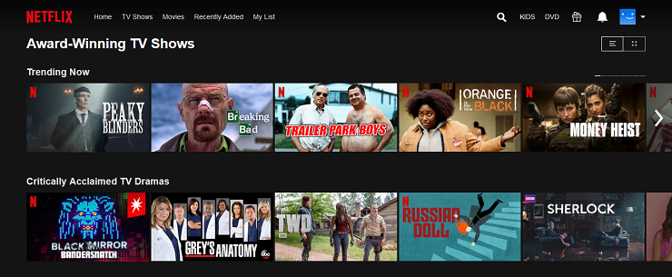
Netflix Background
Founded in 1997 by Marc Randolph and Reed Hastings
Headquartered in Los Gatos, California
One of the world’s leading entertainment platform
Launched its first streaming product in 2007

Slide 3

Scenario
Increase the monthly premium membership from $13.99 to $17.99
Analyze the impact of $4 raise on the growth rate of subscribers
Analyze the revenue and cash flow over the past 10 years
Predict the future cash flow for the next 10 years

Slide 4
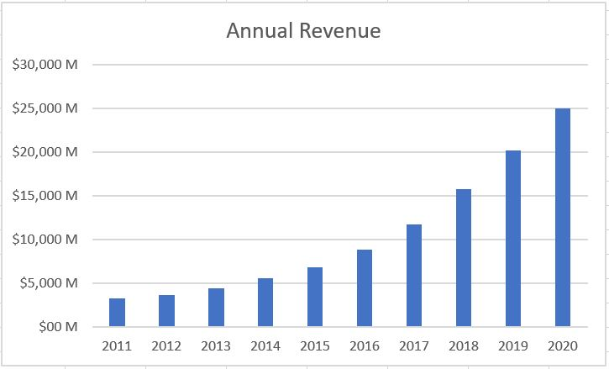
Annual Revenue From 2011 to 2020

Slide 5
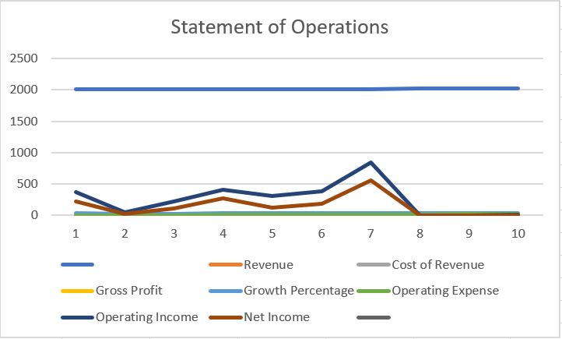
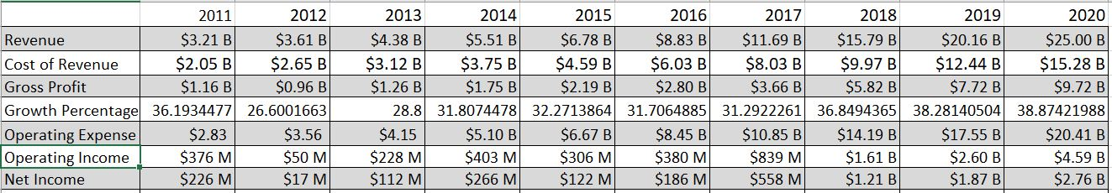
Income Statement

Slide 6
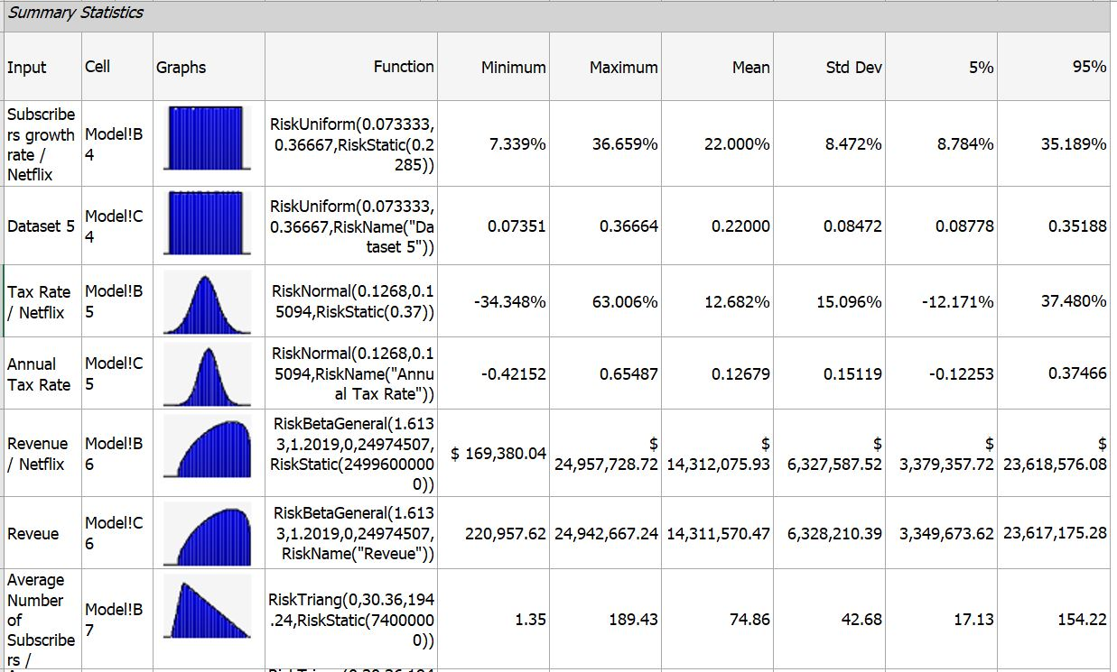
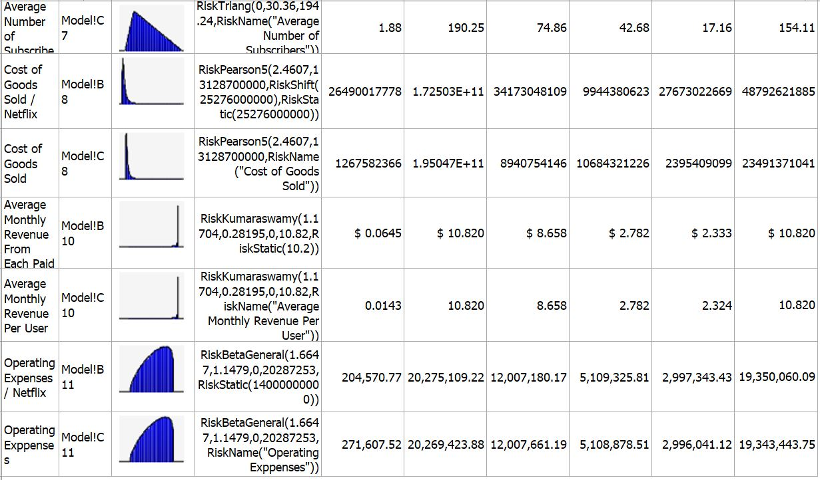
Inputs Distribution

Slide 7
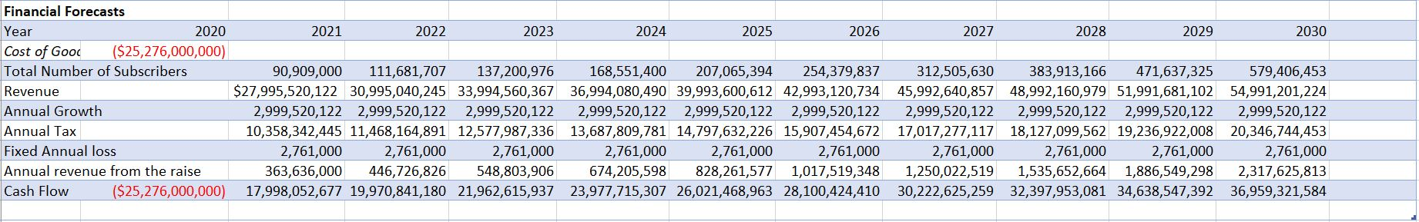
Financial Forecast

Slide 8
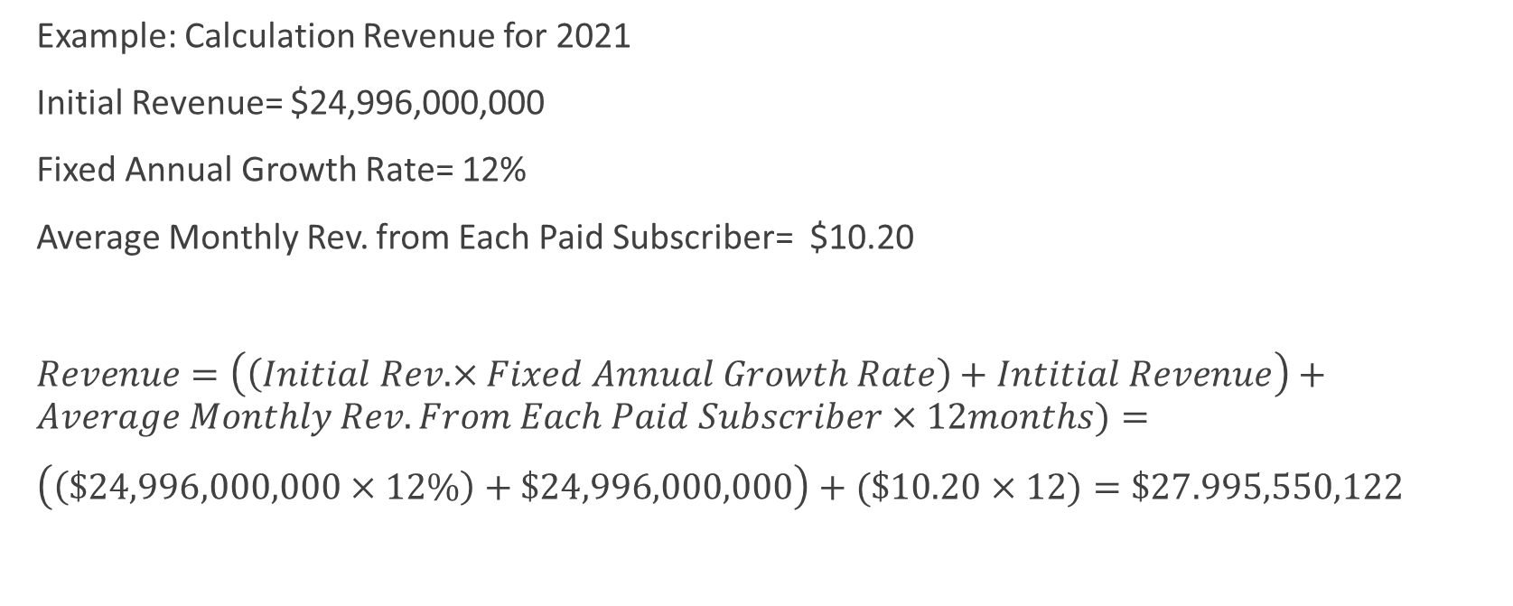
Revenue Forecasts
Example: Calculation Revenue for 2021
Initial Revenue= $24,996,000,000
Fixed Annual Growth Rate= 12%
Average Monthly Rev. from Each Paid Subscriber= $10.20
$Revenue=\left(\left(Initial Rev.×Fixed Annual Growth Rate\right)+Intitial Revenue\right)+Average Monthly Rev. From Each Paid Subscriber×12months)=$
$\left(\left(\$24,996,000,000×12\%\right)+\$24,996,000,000\right)+(\$10.20×12)=\$27.995,550,122$

Slide 9
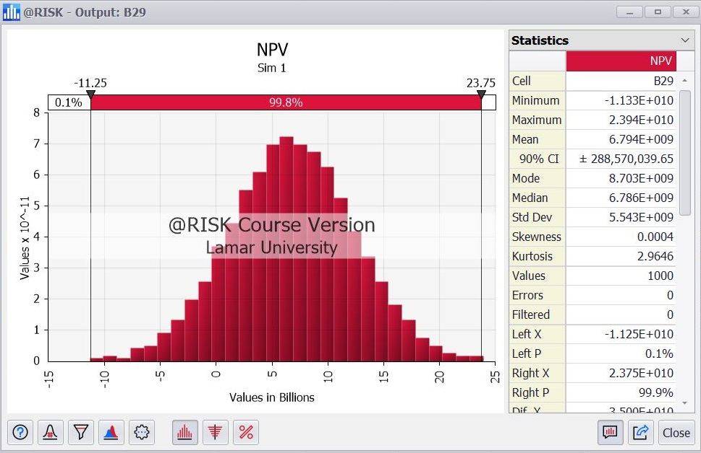
Net Present Value
NPV= 72,541,061,388

Slide 10
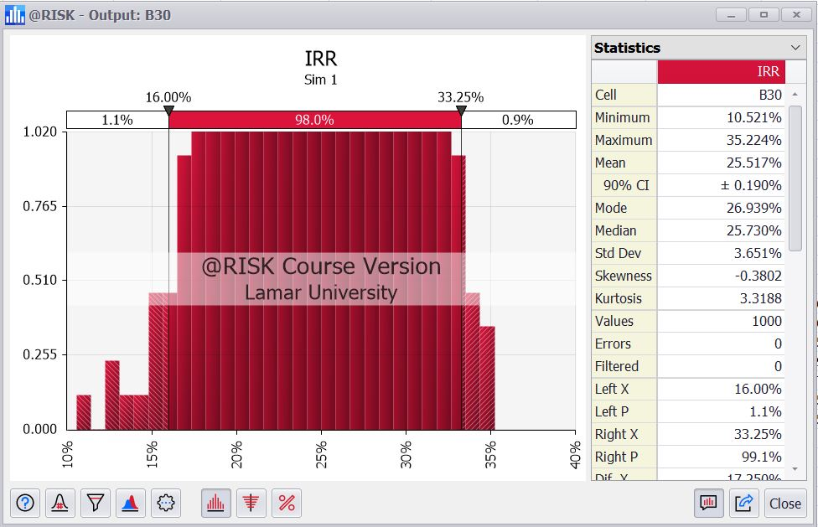
Internal Rate of Return
IRR= 81%

Slide 11
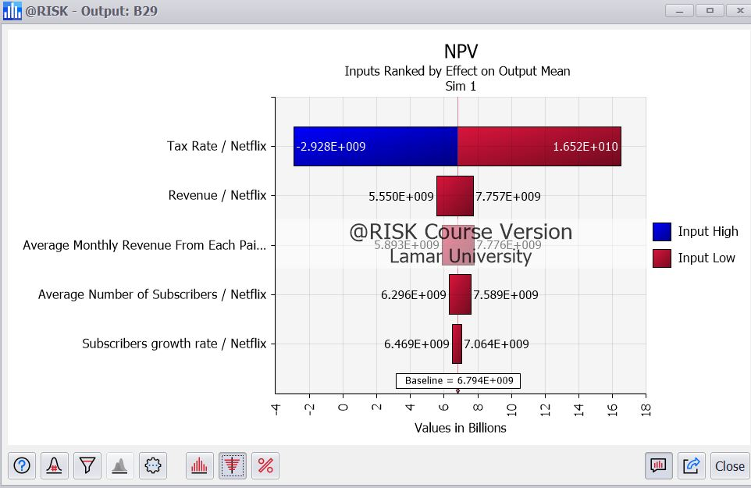
Ranked Inputs

